Slide 1
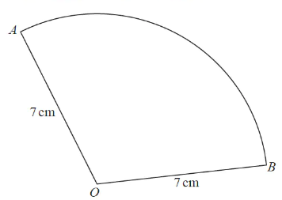
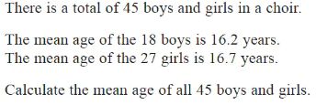
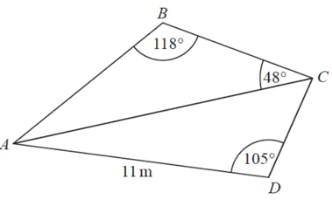
Paper 3 Revision
Sectors
Equations with Algebraic Fraction
Expand Triple Brackets
Expand the following:
(2x + 3) (x – 2) (x + 1)
The area of the sector is 40 cm².
Calculate the length of the arc.
Combined Mean
Sine and Cosine Rule

Slide 2
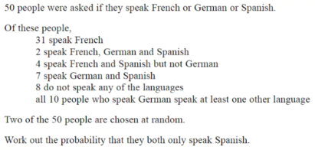
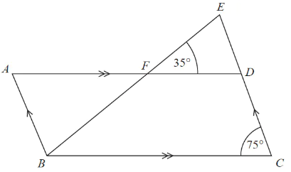
Venn Diagrams
Quadratic Simultaneous Equations
Solve:
Angles in Parallel Lines
Find all missing angles. Please state your reasons.

Slide 3
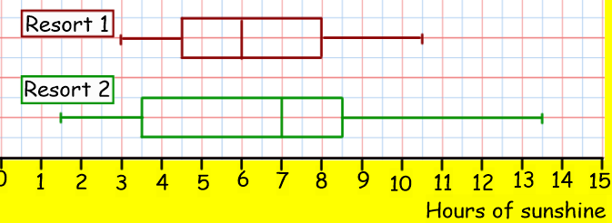
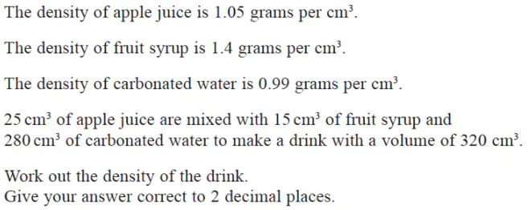
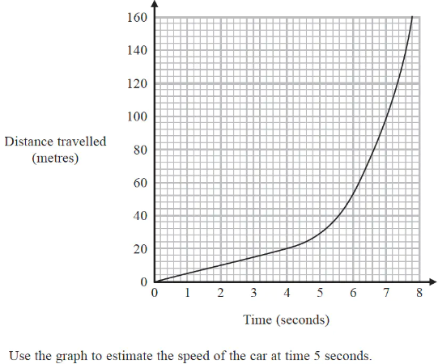
Box Plots
Density, Mass Volume
Compare the following boxplots
Gradient of a curve
Algebraic Proof
Recurring Decimals
Prove that the sum of the following two numbers is always a square number.
Prove that:

